Slide 2
General Terms
DOWNWARD CLOUSURE PROPERTY:
Any subset of a frequent itemset must be frequent .
APRIORI PRUNING PRINCIPLE:
If there is a itemset that is not frequent , the superset should not be generated.
Support:
Confidence:

Slide 3
Outline /Steps of apriori
Scan the db to get 1-itemset.(k)
{Lets suppose there is item in transactions named “A”, it does not have a support greater than or equal to minimum support count, so there is no need to use A item in generating the 2 candidate itemsets}
Generate the 2 candidate itemsets (k+1) itemsets.
Test the candidates against db
Terminate when no frequency or candidate set can be generated.

Slide 4
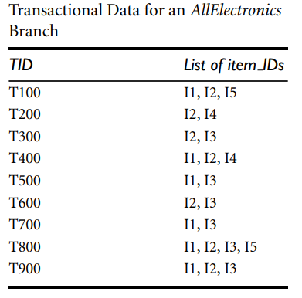
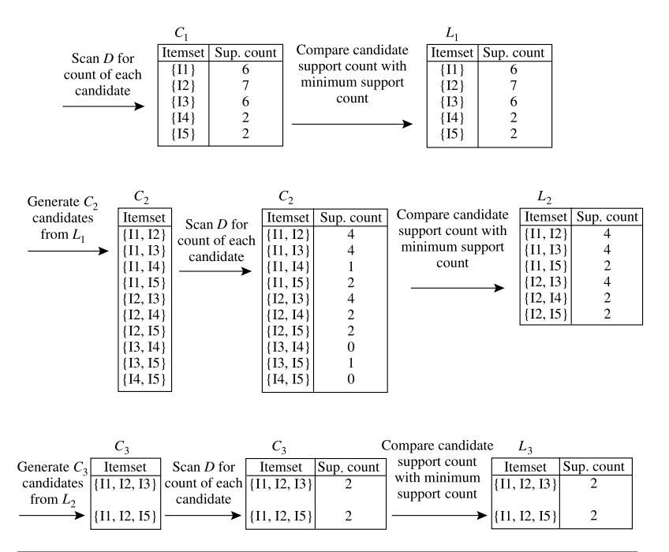

Slide 5
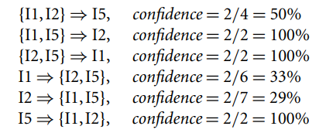
Association rules after Frequent Itemsets L1,L2….Lk
For each frequent itemset l, generate all nonempty subsets of l.
For every nonempty subset s of l, output the rule “s ⇒ (l − s)” if support count(l) support count(s) ≥ min conf, where min conf is the minimum confidence threshold.

Slide 6
When do we scan the db and how often?
Scanning the transaction database is done very frequently to calculate the support count of candidate itemsets and determine their frequency in the dataset.
In simple words ,
if the lengthiest frequent itemset is of size k, the database is scanned k times, specifically in the final iteration(kth) to generate the frequent itemsets of size k (Lk) from the candidate itemsets of size k (Ck)

Slide 7
When and why might apriori algorithm take two long?
When the data set is large.
When the minimum support is very low compared to number of transactions of tuples.
When the data set is large, it means that it contains more number of transactions, so the database needs to scan it multiple times while filtering out the candidate itemsets into frequent itemsets.
And when the data set is too large and the minimum support is small, we can understand that there will be many and many frequent itemsets that will be generated.

